Slide 1
Week 13 – Introduction to Data Analytics in Python
(CLO4)

Slide 2
Learning Outcomes
Data Visualization.
Understand the different types of charts.
Plotting 3 different types of charts
Enhancing the chart

Slide 3
Data Visualization
Using charts to visualize data helps with improving understanding of a data set,
interpretation of the data and communications among people who work with it.
Pandas offers many chart that are suitable for use within management or corporate presentations.
A chart can create a clearer picture of a set of data values than a DataFrame with rows and columns, allowing managers to incorporate this understanding into analysis and future planning.
It is important that x-axis will be the index of your DataFrame. If you want to have a
specific column to be your x-axis, then you need to set the index to that column.

Slide 4
Comparison of different charts.
Graph Type | Advantage | Disadvantage
Line graph A line graph plots continuous data as points and then joins them with a line. Multiple data sets can be graphed together, but a key must be used. | Can compare multiple continuous data sets easily Interim data can be inferred from graph line | Use only with continuous data
Bar graph A bar graph displays discrete data in separate columns. A double bar graph can be used to compare two data sets. Categories are considered unordered and can be rearranged alphabetically, by size, etc | Visually strong Can easily compare two or three data sets | Graph categories can be reordered to emphasize certain effects Use only with discrete data
Pie chart A pie chart displays data as a percentage of the whole. Each pie section should have a label and percentage. A total data number should be included. | Visually appealing Shows percent of total for each category | No exact numerical data Hard to compare 2 data sets "Other" category can be a problem Total unknown unless specified Best for 3 to 7 categories Use only with discrete data

Slide 5
Comparison of different charts.
Graph Type | Advantage | Disadvantage
Histogram A histogram displays continuous data in ordered columns. Categories are of continuous measure such as time, inches, temperature, etc. | Visually strong Can compare to normal curve Usually vertical axis is a frequency count of items falling into each category | Cannot read exact values because data is grouped into categories More difficult to compare two data sets Use only with continuous data
Pictograph A pictograph uses an icon to represent a quantity of data values in order to decrease the size of the graph. A key must be used to explain the icon. | Easy to read Visually appealing Handles large data sets easily using keyed icons | Hard to quantify partial icons Icons must be of consistent size Best for only 2-6 categories Very simplistic
Map chart A map chart displays data by shading sections of a map, and must include a key. A total data number should be included. | Good visual appeal Overall trends show well | Needs limited categories No exact numerical values Color key can skew visual interpretation
Source: https://www.whaqualitycenter.org/Portals/0/Tools%20to%20Use/Making%20Sense%20of%20Data/Using%20Graphs%20to%20Display%20Data%20R%202-12.pdf

Slide 6
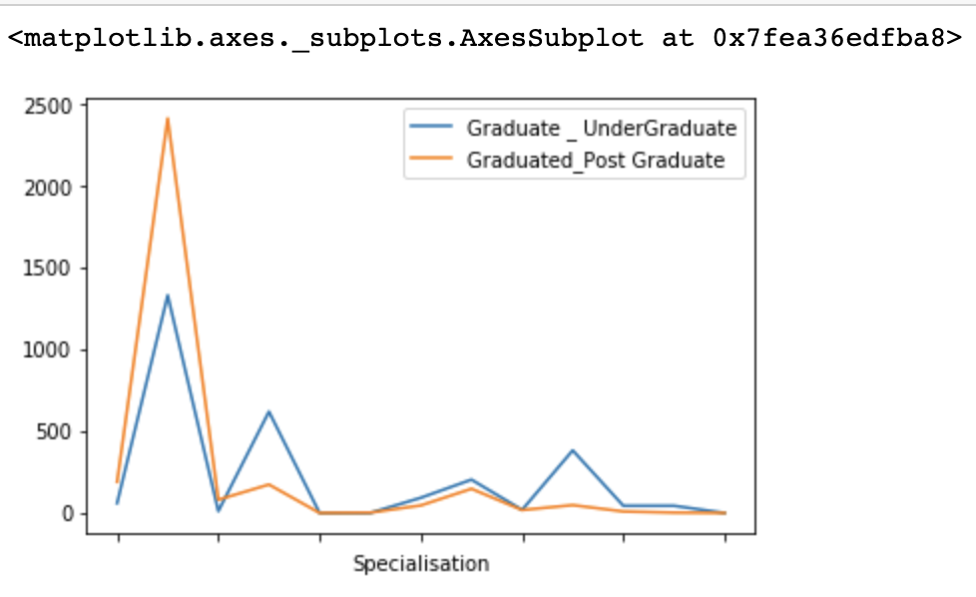
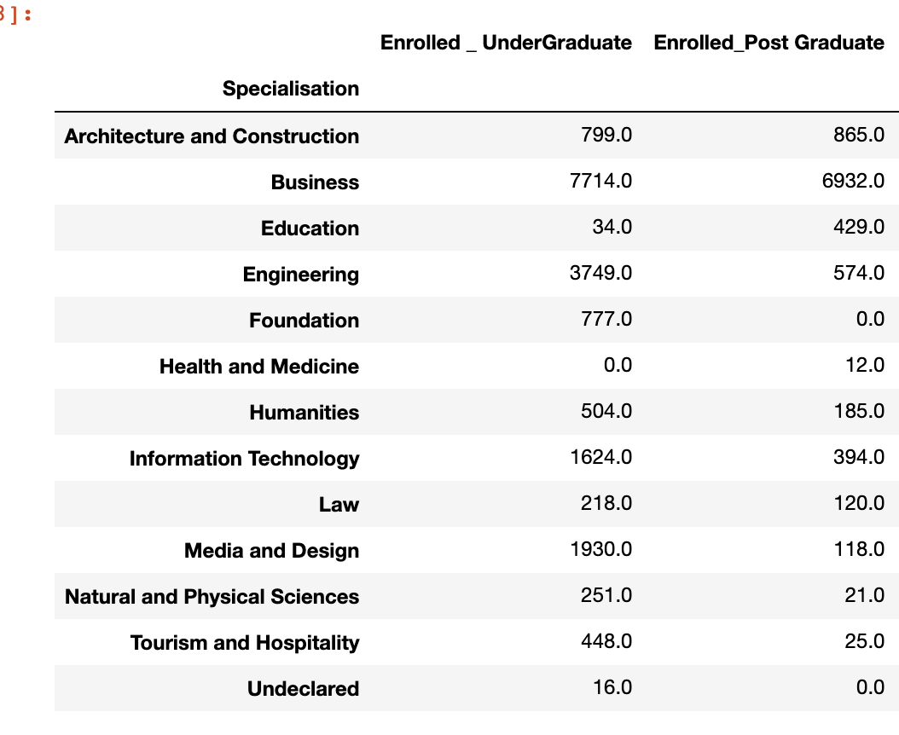
Plotting a Line Chart
A line graph plots continuous data as points and then joins them with a line. Multiple data sets can be graphed together, but a key must be used.
The structure of the command line is:
DataFrame[Column].plot()
DataFrame[Column].plot.line()
Example:
A line chart to display number of students enrolled in Undergraduate and Post Graduate
df[['Graduate _ UnderGraduate','Graduated_Post Graduate']].plot()

Slide 7
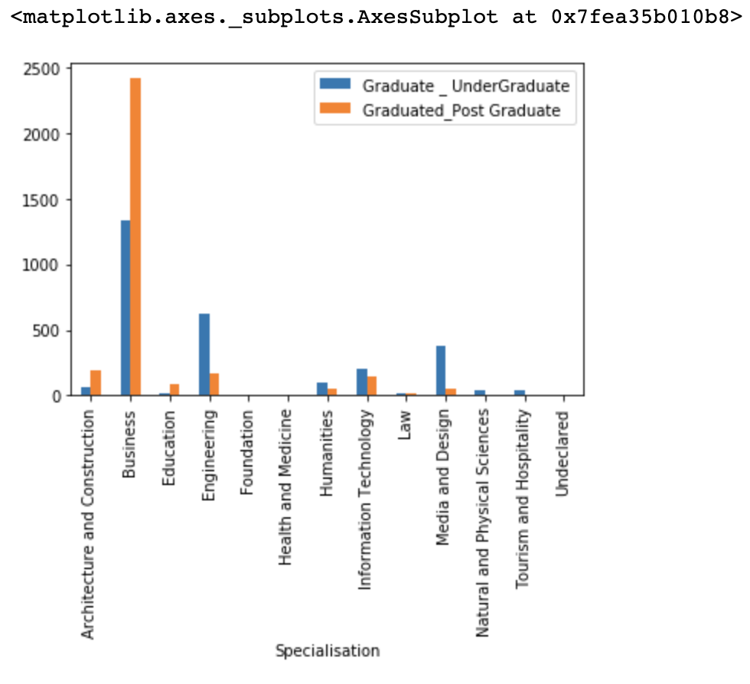
Plotting a Bar Chart
A bar graph displays discrete data in separate columns. A double bar graph can be used to compare two data sets.
The structure of the command line is:
DataFrame[Column].plot.bar()
Example:
A bar chart to display number of students enrolled in Undergraduate and Post Graduate in each Specialisation
df[['Graduate _ UnderGraduate','Graduated_Post Graduate']].plot.bar()

Slide 8
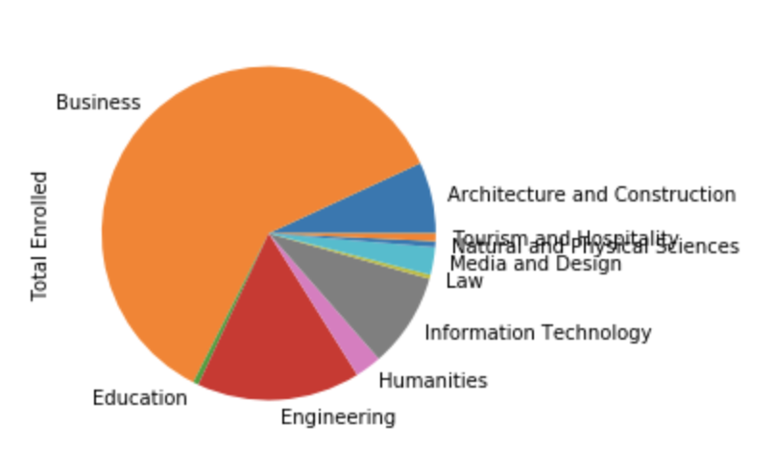
Plotting a Pie Chart
A pie chart displays data as a percentage of the whole. Each pie section should have a label and percentage. A total data number should be included.
The structure of the command line is:
DataFrame[Column].plot.pie()
Example:
A pie chart to display total number of students enrolled in each specialisation
df['Total Enrolled'].plot.pie()

Slide 9
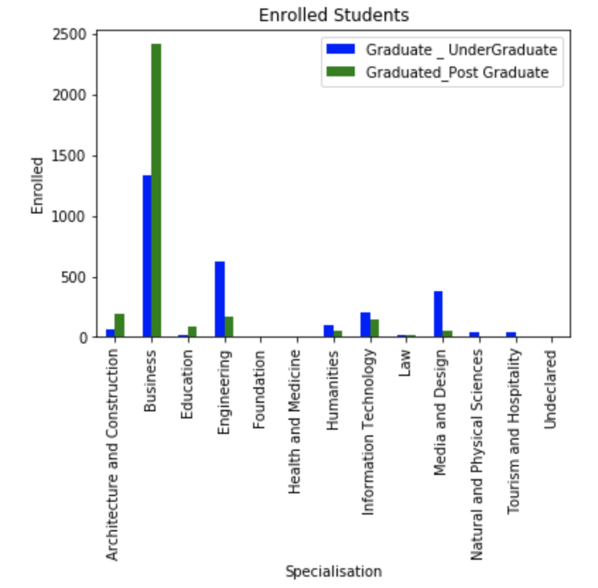
Enhancing the Chart - Example
1. Create a bar chart with title and change colours
chart = df[['Graduate _ UnderGraduate','Graduated_Post Graduate']].plot.bar(title='Enrolled Students',color=["Blue","Green"])
Title
2. Change the x and y label
chart.set_xlabel('Specialisation’)
chart.set_ylabel('Enrolled')
Colours
Y-label
X-label

Slide 10
Summary of Pandas Commands
Display chart
DataFrame[Column].plot.line()
DataFrame[Column].plot.bar()
DataFrame[Column].plot.pie()
Enhance
title = “your title”
color = [‘colour1’,’colour2’]
set_xlabel(‘x_label’)
set_ylabel(‘y_label’)

